Slide 1
Aspire Plus
Bus Conversion

Slide 2
February 19-February 20
In February we started our biggest and most ambitious project to date. Our pupil council had been tasked with exploring ideas for what students could do during break and lunch. One of the things that was highlighted was that there was no where that students could go and spend time with friends. We looked at some places around the school site but couldn't find anywhere that felt appropriate. Then, we had an idea…. What if we converted an old bus. After much research we found the perfect one and at half term “Bertha” was delivered. During the February half term we set to stripping out the interior and deep cleaning, this meant we could now fully the size of the task ahead.

Slide 3
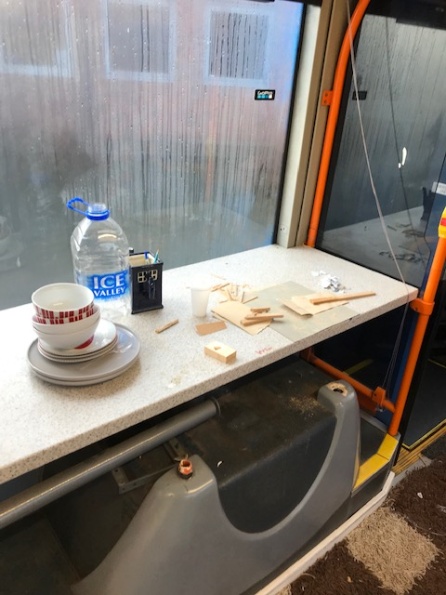
Designing an interior

Slide 4
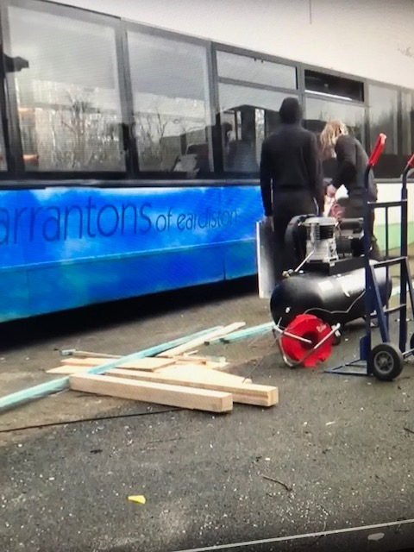
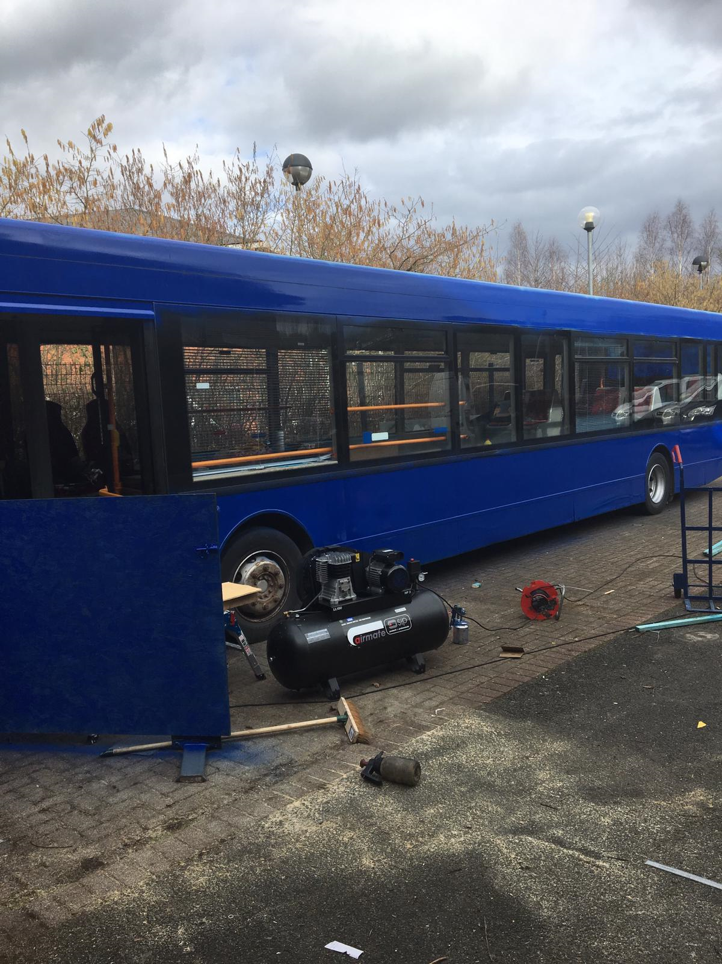
Easter…
Now the interior was starting to take shape we turned our attention to the exterior of the bus and the surround areas. we wanted to give the bus a strong identity so opted for bright blue. Cleaning and preparing the bus took three days but all that effort was worth it. Along side the bus students wanted to create a garden that they could tend so a flower bed was added.

Slide 5
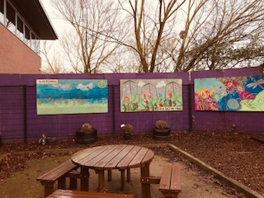
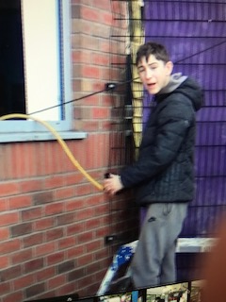
Art Work
To further add to the atmosphere students created unique artwork for the outside areas.

Slide 6
Summer
The six weeks summer Holiday is the busiest time for the Aspire Plus team. We spent another week on the Isle of Wight, Camped at a local farm, visited museums, spent a day at Weston super-Mare but we still had time for more work on the Bus.

Slide 7
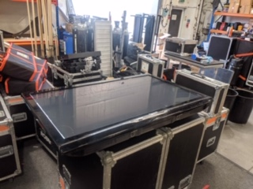
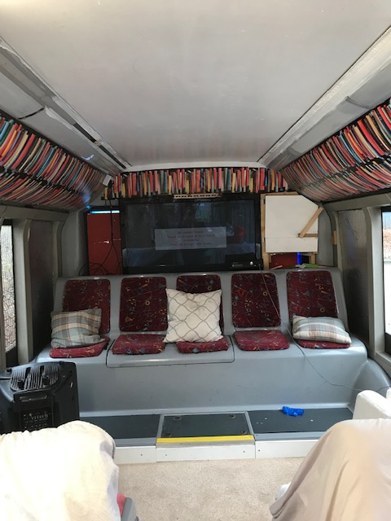
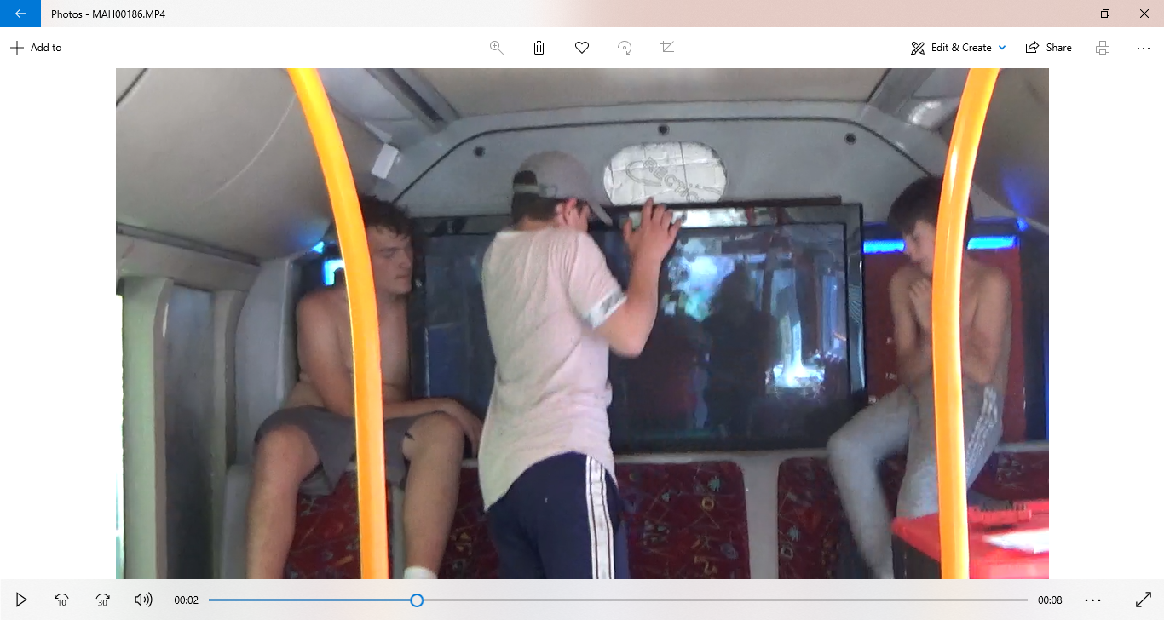
Now that we had cleared out the back section of the bus and had electric we now had space for a television and console. Production Support services of Bromsgrove very kindly donated a brand new Plasma to us.

Slide 8
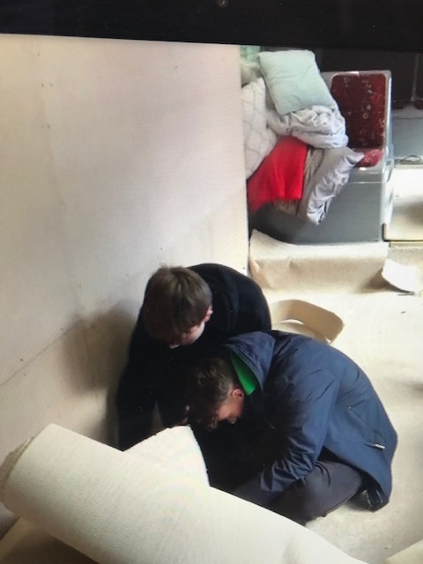
October
As the colder weather set in it was getting chilly on the bus even with our new heaters. To combat this we contacted local Carpet companies to see if they had any surplus stock they no longer needed. Amazingly local carpet suppliers Carpet right had 20 feet of plush cream carpet that they were happy to donate. Fitting was done over two days with the help of some of our year 11’s.

Slide 9
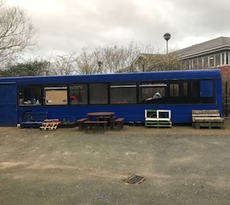
Christmas
We Finished off the year by sitting back and enjoyed using the bus for its purpose, we created a feast and had our Christmas lunch on the bus and we look forward to much more happening to it in 2020.

